Slide 1
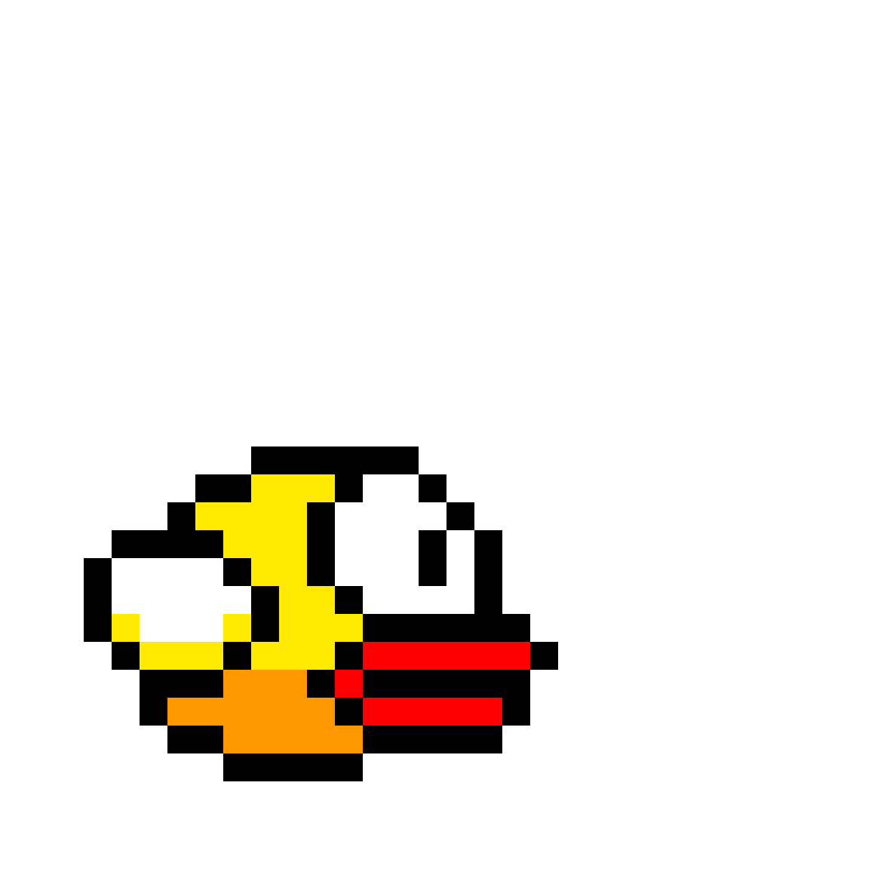
FLAPPY BIRD 2.0
BY: Sigodi Lutho , Ntsaluba Abona , Makgaloa Tshephang , Tantsi Okoyama Nomafaku

Slide 2
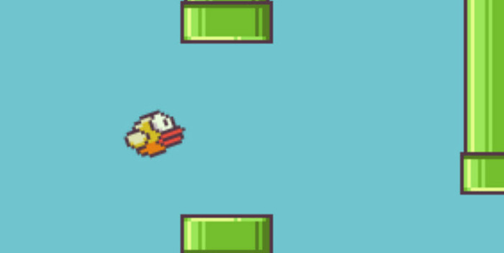

Aim of the game:
The primary goal in Flappy Bird is to guide a bird through a series of pipes with varying heights. The player aims to navigate through as many pipes as possible without colliding with them. Each successful pass through a set of pipes earns the player points.
Rules of the game:
If the bird touches one of the pipes or the ground. GAME OVER!!

Slide 3
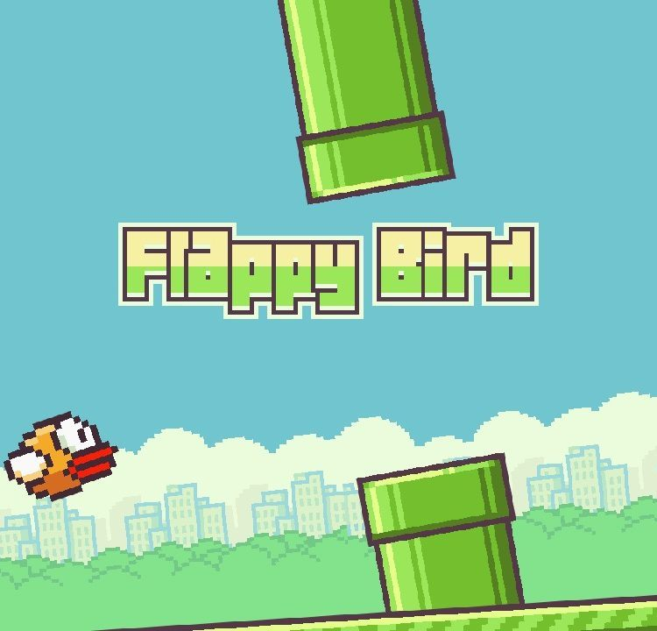

MAIN FRAME

Slide 4
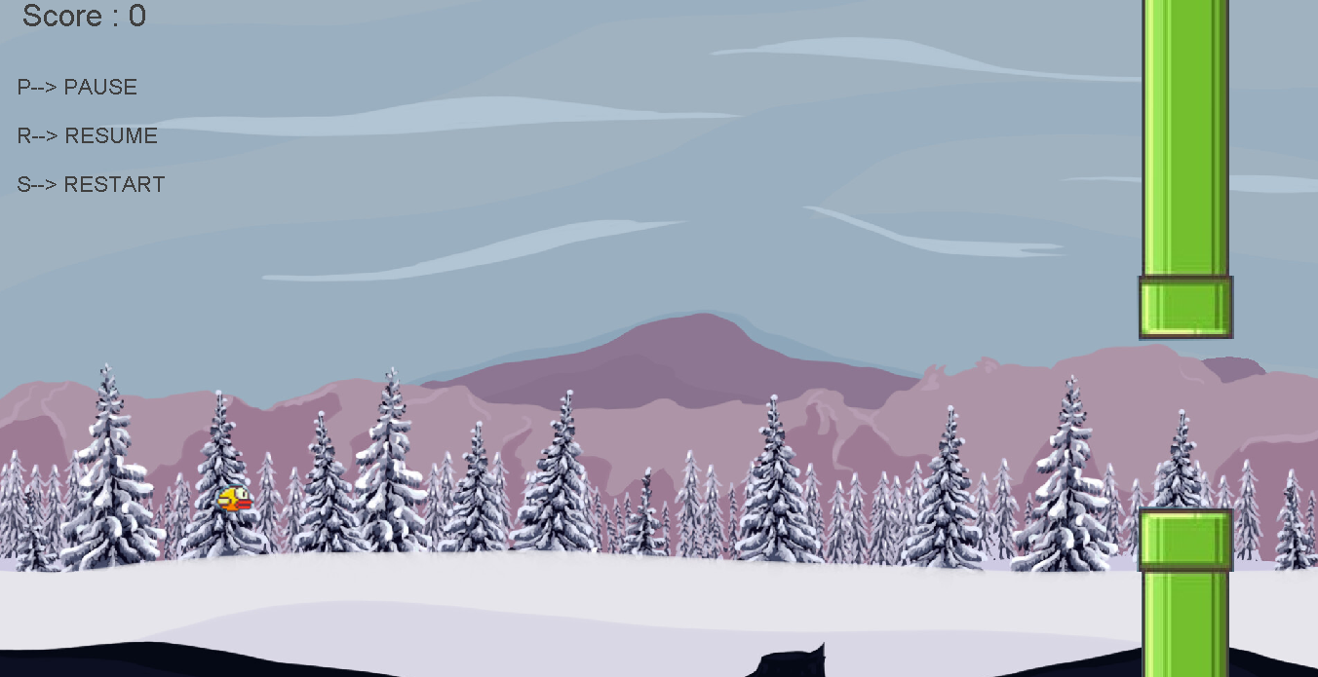
GAME LOOP

Slide 5

GAME ENDS

